Slide 1
STOMACH AND DUODENUM
Jawad R Alkharasani
FCABS FICMS FICS
Consultant Gastrointestinal& Hepatobiliary Surgeon

Slide 2
Surgical treatment of Bleeding PU.
Indication:
Continuous bleeding that demands massive blood transfusion.
Failed endoscopic Rx.
Rebleeding after endoscopic Rx.

Slide 3
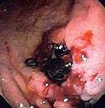
Surgical treatment of Bleeding PU.(Cont.)
Endoscopic stigmata of high rebleeding rate:
Spurting vessel.
Visible vessel at ulcer base.
Clot overlying ulcer base.

Slide 4
Treatment:
Aim of Rx: Stop the bleeding :
Q/ Where is Commonest site of bleeding duodenal ulcer?
Q/ From which vessel?
Action:
Longitudinal pyloro-duodenotomy.
Under- running of bleeding vessel.
Closure by pyloroplasty.
+/- Vagotomy : TV. OR HSV.

Slide 5
Treatment .(Cont.)
Bleeding gastric Ulcer.
Q/ What is the expected artery that cause the bleeding?
Q/ What is the crucial step in treatment of gastric ulcer bleeding in addition to stopping bleeding?

Slide 6
Treatment .(Cont.)
Stress ulcer.
Gastric erosion.
Mallory-Weiss tear.
Same principles of Rx.
Dieulafoy’s disease: gastric arterial venous malformation.
Rxed by local excision.

Slide 7
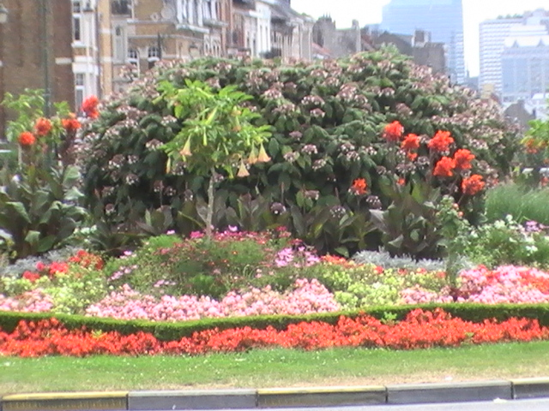

Slide 8
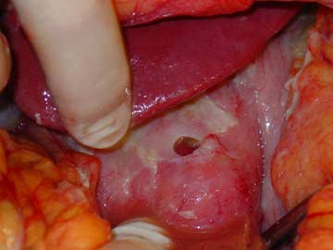
Perforated peptic ulcer:
Incidence little changed .
Previously middle age.
2:1 M: F.
Now more in elderly.
More F.

Slide 9
Pathogenesis
Q/ What is the commonest expected site of perforation of DU?
Q/ What is the commonest expected site of perforation in GU?

Slide 10
Pathogenesis.(Cont.)
Q/ What is the sequel of GU perforation?
Irritant effect of gastric content and acid chemical peritonitis.
After few hrs bacterial peritonitis.
Septic peritonitis septic shock.

Slide 11
Pathogenesis.(Cont.)
If only leak( small perforation):
Q/ How it could mimic acute appendicitis?
Some perforation will seal by inflammatory response and adhesion,
The fluid track down from epigastric through Rt paracolic gutter to Rt. iliac fossa.
Q/ Is there any chance for the perforation to be self- limiting?

Slide 12
Clinical features
Sudden onset severe upper abdo. pain.
Q/ What are other DDx?
Then became generalized.
Hx of PU, NSAID
Tachycardia or shock state.
Fever (late)
Restricted abdominal movement with respiration.
Pointing sign (early).
Signs of peritoneal irritation:
Tenderness, rebound, gaurdining or rigidity (board- like).
-ve BS.
Septic shock.

Slide 13
Investigations
Plain chest X-ray: air under diaphragm.(50%).
CT scan more accurate.
It differentiate from other possible pathology as acute pancreatitis( both have elevated serum amylase).

Slide 14
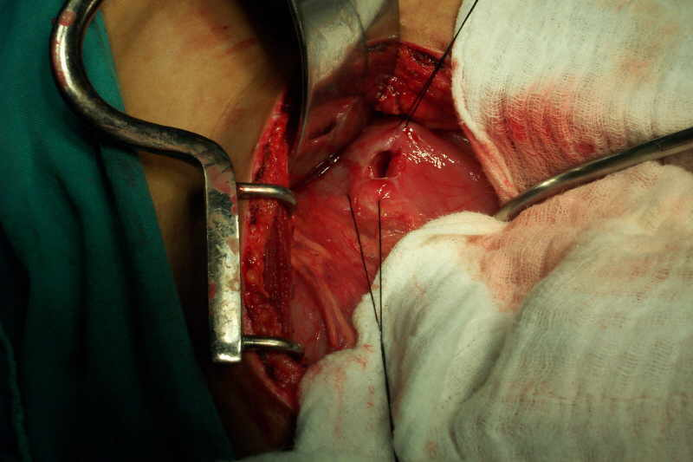
Treatment
Admission, Resuscitation
IV fluid and analgesia.
IV Antibiotics.
Opened surgery. OR
Laparoscopic surgery.
Duodenal perforation:
Closure over omental patch( Graham patch).
Through peritoneal toilet(wash)
NG tube.
Eradication of H. pylori.

Slide 15
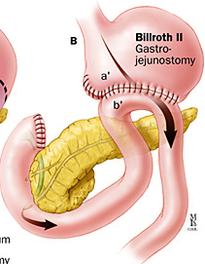
Treatment (cont.)
Gastric perforation:
Excision of the ulcer and suturing. OR
Closure and biopsy..
Rarely if closure is impossible Gastrectomy may be needed. (Bilroth II).
Q/ What are the main differences between surgical treatment of DU and GU perforation?

Slide 16
Q/ What are common in surgical treatment of DU and GU perforation?

Slide 18
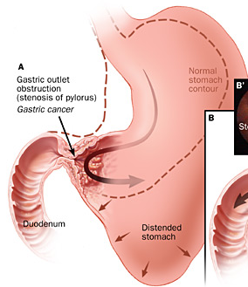
Gastric outlet obstruction (GOO)
Two common causes:
Gastric cancer.
Stenosis secondary to PU.
Other causes:
Adult pyloric stenosis.
Pyloric mucosal diaphragm.

Slide 19
Clinical features
Benign GOO:
Hx of chr. PU symptoms.
Vomiting , no bile( if complete),
Undigested food of previous meal.
Wt loss, un well.
Dehydration.
Distended abdomen.
Succussion splash.

Slide 20
Clinical features (Cont.). Metabolic effect:
Hypochloremic alkalosis.
Hyponatremia.
Urine acid paradox.
Hypokalemia.
Alkalosis lead to low ionized calcium,
Tetany.

Slide 21
Management:
Main 2 steps:
Correction of metabolic abnormality.
Treating the mechanical obstruction.

Slide 22
Management:
Rehydration 0.9% Nacl with k⁺ suplement.
Correction of associated anemia.
Decompression of stomach. N/GT.
Investigation by :
OGD + What and Why?
contrast radiology.
Conservative Rx:
In early case as the edema subside.
Endoscopic balloon dilatation / risk.?

Slide 23
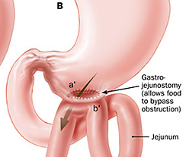
Management (cont.)
Surgery: drainage
PP.
GJ.
Resection for malignancy.
Gastrectomy

Slide 24
Gastric polyps
Types:
Metaplastic polyp: H.pylori realted.
Inflammatory polyp.
Fundic gland polyp: PPI related.
Adenomatous polyp:10% malignant potential.
Gastric carcinoid polyp: ECL cells.

Slide 25
Gastric polyps
Rx:
Biopsy is essential.
Snaring polypectomy.
Surgical excision.

Slide 26
Gastric Cancer

